Slide 1
Secure Data Hiding in Image Using Steganography
CAPSTONE PROJECT
Presented By:
Student Name: VANAMALA SURYA PRAKASH REDDY
College Name & Department: VIKRAMA SIMHAPURI UNIVERSITY COLLEGE KAVALI NELLORE(D) & DEPARTMENT OF COMPUTER APPLICATIONS

Slide 2
OUTLINE
Problem Statement
Technology used
Wow factor
End users
Result
Conclusion
Git-hub Link
Future scope

Slide 3
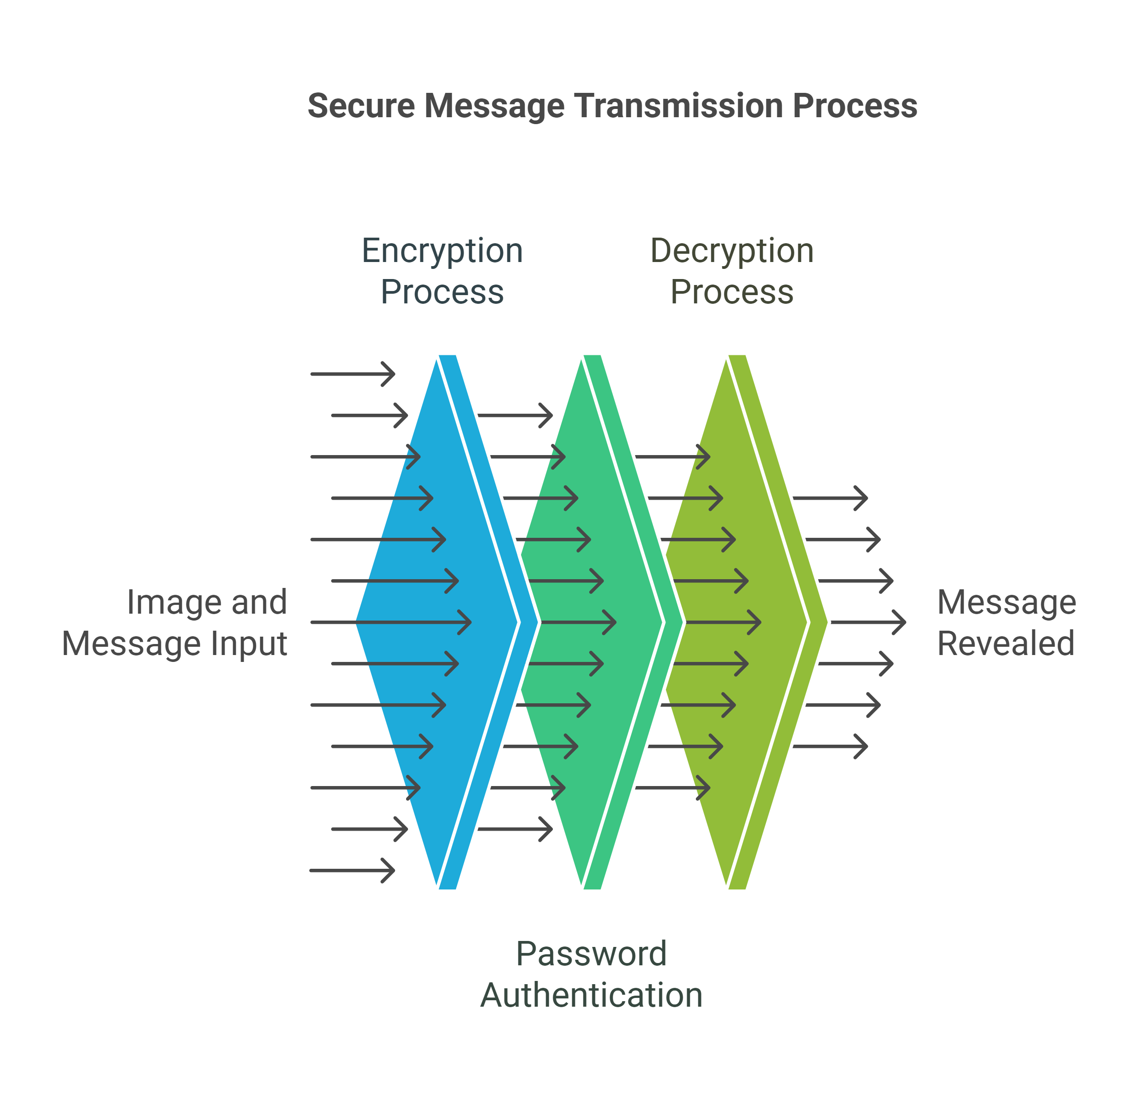
Problem Statement
Secure Image-Based Message Transmission
Develop a program that enables secure transmission of textual messages by embedding them within digital images using steganography. The program should implement both encryption (embedding) and decryption (extraction) functionalities, incorporating a password-based access control mechanism to ensure message confidentiality.

Slide 4
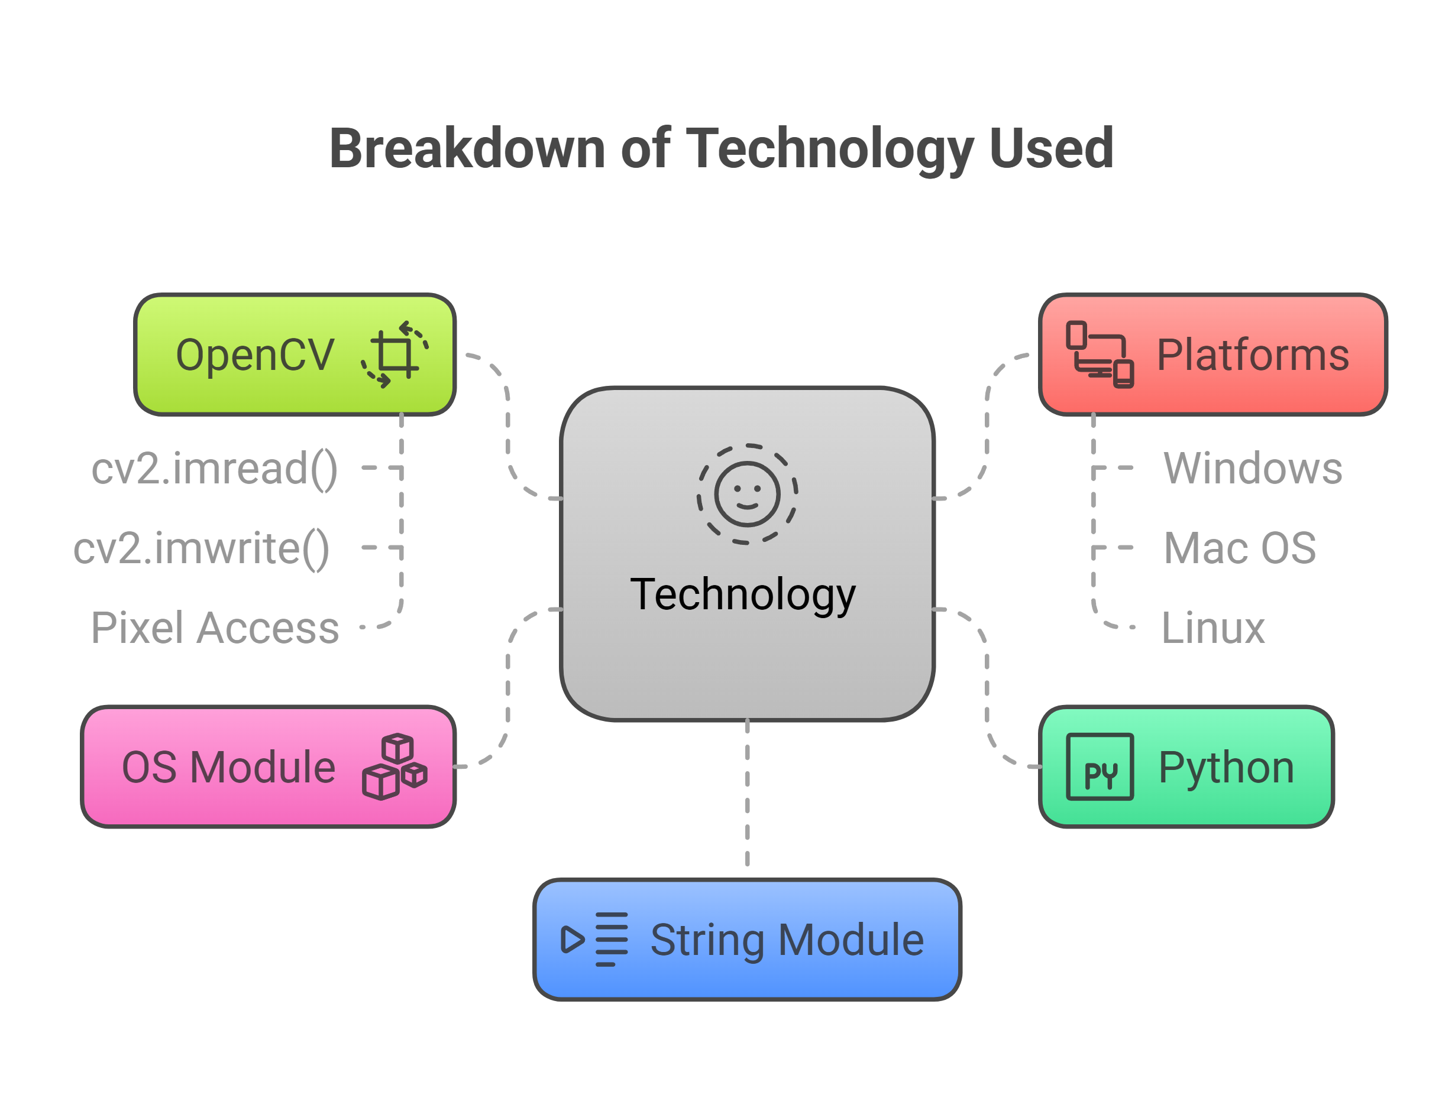
Technology used
Python: The entire program is written in Python, a high-level, general-purpose programming language known for its readability and versatility.
OpenCV(cv2): This is the primary library used for image processing. Specifically, it provides functionalities like:
cv2.imread(): Reads an image file (JPG, PNG) into a numpy array, which represents the image’s pixel data
cv2.imwrite(): Writes an image (represented as a numpy array) to a file. We need to specify the filename and format (JPG, PNG).
Pixel Access: OpenCV allows you to access and modify individual pixel values within the image. The code uses this to embed the message.
OS Module: This module provides a way of using operating system-dependent functionality. We use the os.system() function to open the encrypted image.
String Module: While not directly used in the current code, the string module is often useful in steganography for string manipulation tasks.
Platforms: This code is written in Python and can be run on any platform that supports Python and the required libraries(OpenCV). The platforms( Windows, Mac os, Linux) we are using Windows OS for better understanding and execution.

Slide 5
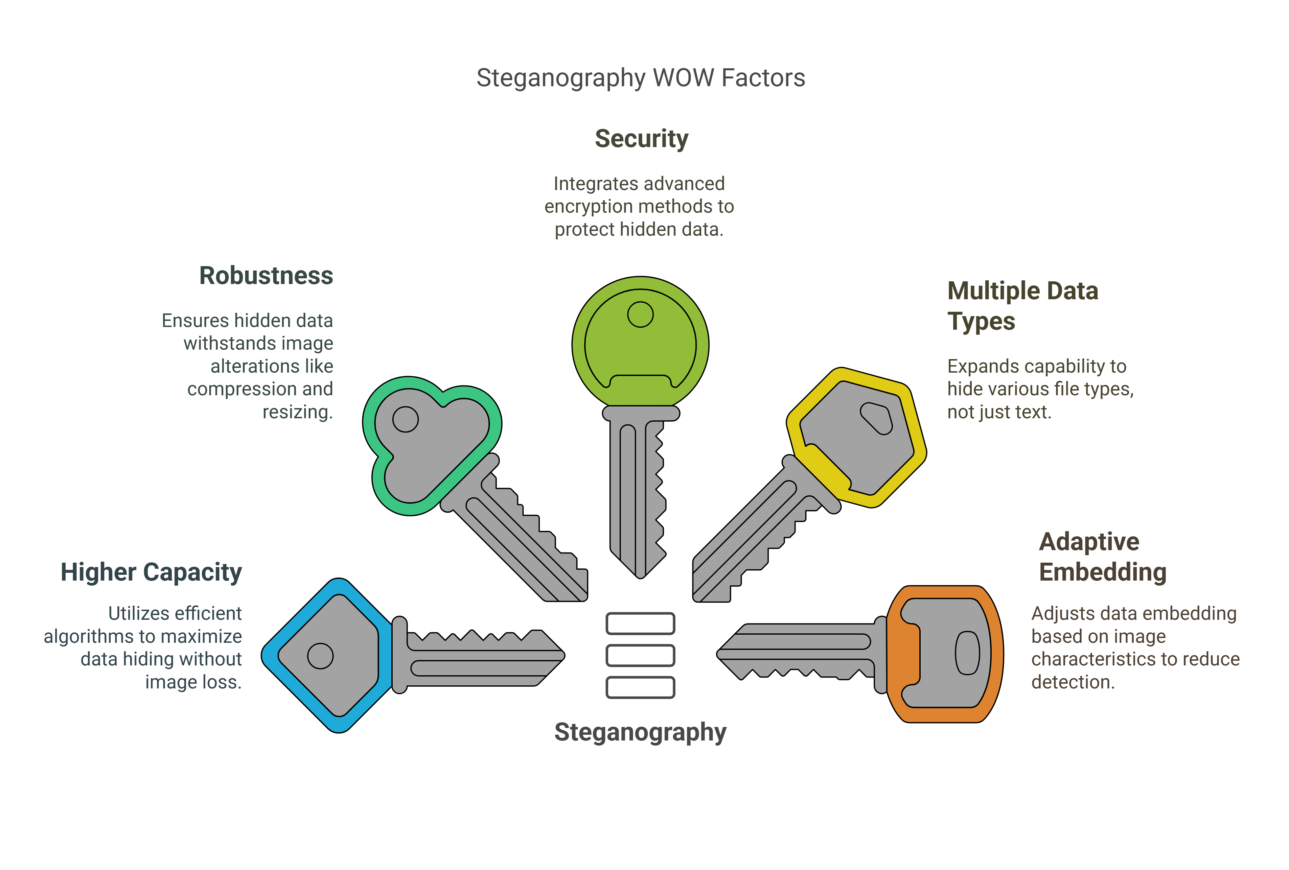
Wow factors
Higher Capacity: Implement a more efficient steganography algorithm (like using multiple LSBs or frequency domain methods) to significantly increase the amount of data that can be hidden without noticeable image degradation. Showcase the capacity improvement.
Robustness: Make the hidden data more resistant to image manipulation (compression, resizing, cropping). Explore techniques that distribute the data or use error correction codes. Demonstrate the robustness by showing how the message survives transformations.
Security: Go beyond a simple password. Integrate proper encryption (AES, RSA) before the data is embedded. This makes it much harder for someone to extract the data even if they suspect steganography is used. Highlight the encryption method.
Multiple Data Types: Allow hiding not just text, but also other file types (images, audio, small videos) within the cover image. This adds significant versatility.
Adaptive Embedding: Develop an algorithm that analyzes the image and dynamically adjusts the embedding strength to minimize any detectable changes. This could be based on image complexity or perceptual models.

Slide 6
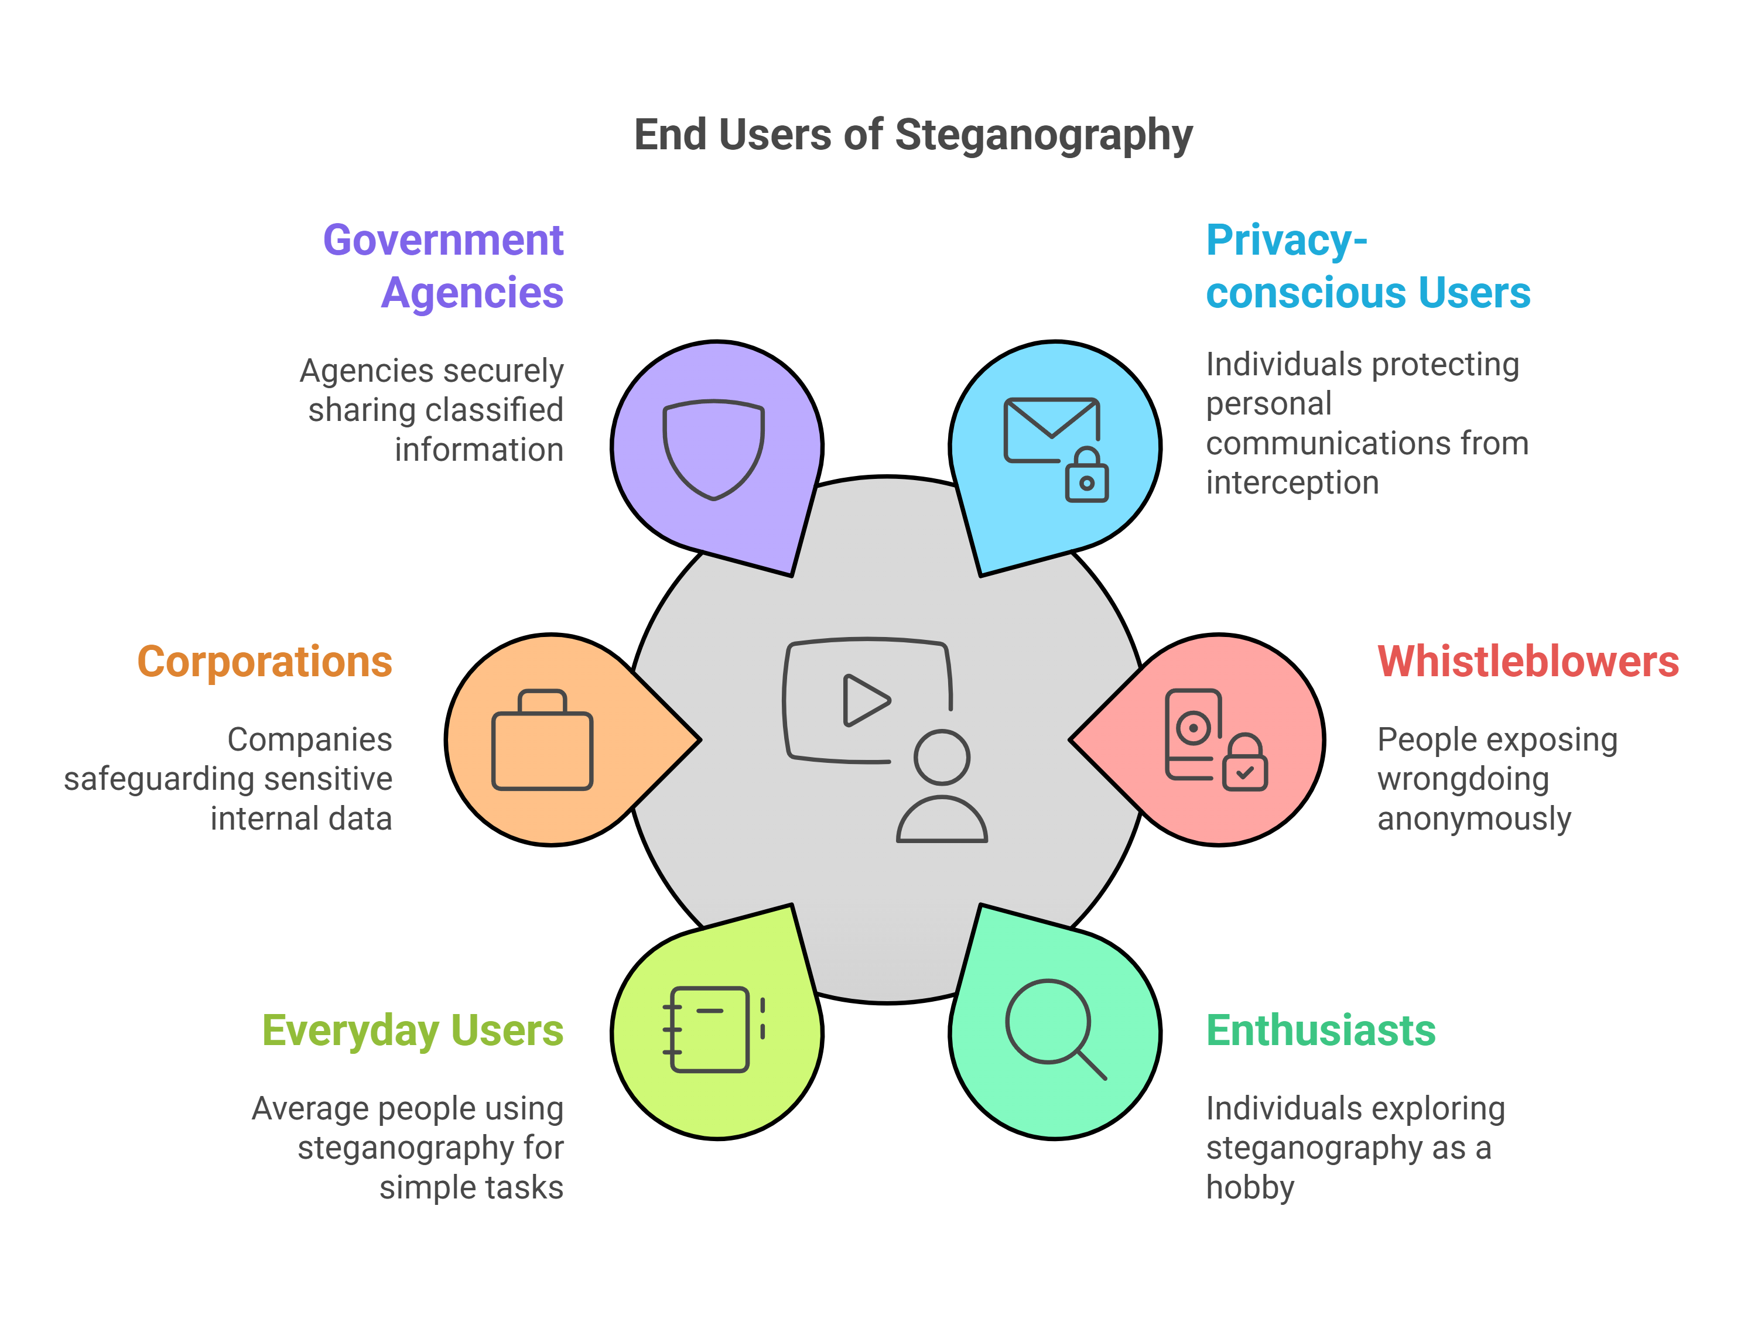
End users
Privacy-conscious users: Individuals concerned about the privacy of their communications might use steganography to send messages or share files discreetly, shielding them from prying eyes. This could be for personal or sensitive information they don't want easily intercepted.
Whistleblowers: Those who want to expose wrongdoing but fear retaliation might use steganography to anonymously share evidence or communicate with journalists or other trusted parties.
Enthusiasts and hobbyists: Some people are simply fascinated by the technical challenge and the cleverness of hiding information in plain sight. They might experiment with steganography for fun or educational purposes.
Everyday users: While not as common, the average person might use steganography for simple things like hiding a password in a digital photo or embedding a small note in a shared image.
Corporations: Companies might use steganography for internal communication, hiding sensitive data within seemingly innocuous files. This could include strategic plans, financial information, or intellectual property.
Government agencies: Intelligence agencies and law enforcement might use steganography to exchange classified information or coordinate covert operations.

Slide 7
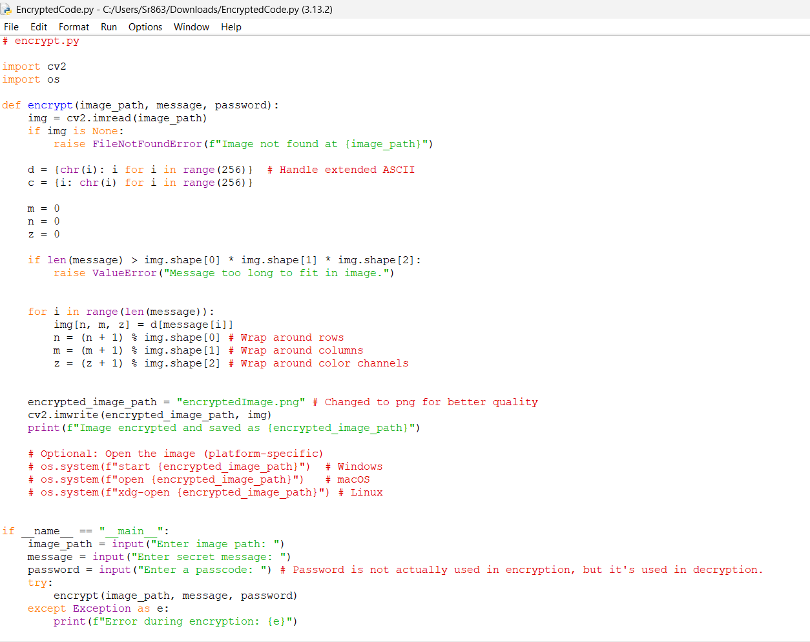
Results

Slide 8
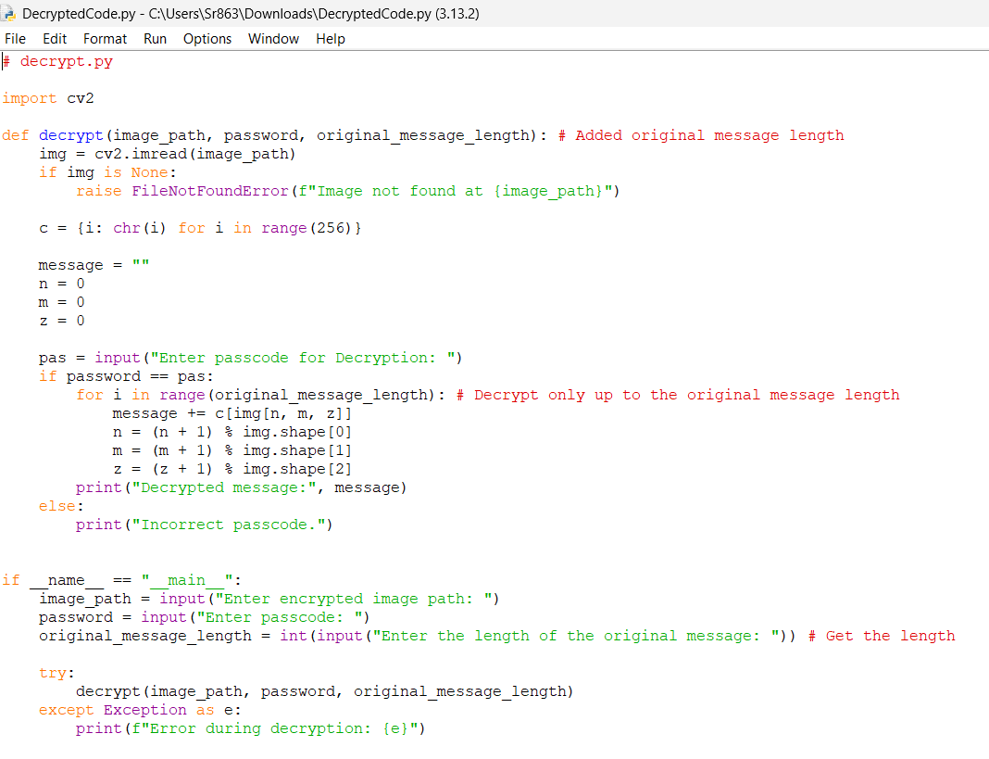

Slide 9
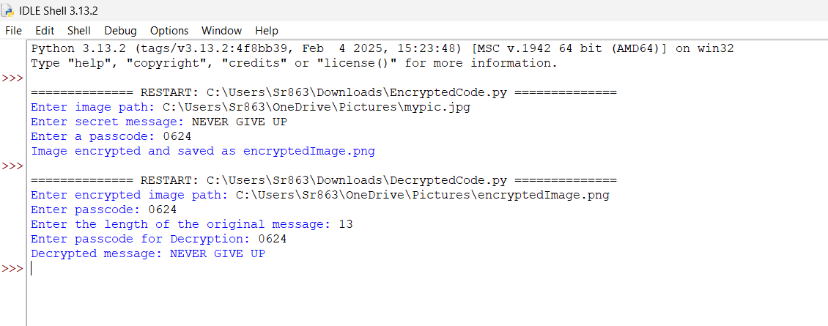

Slide 10


My Pic
Encrypted Image

Slide 11
Conclusion
This steganography project has successfully demonstrated the feasibility and effectiveness of secure image-based message transmission. By developing a program that seamlessly integrates encryption (embedding) and decryption (extraction) functionalities, we have created a practical tool for concealing textual information within digital images. The incorporation of a password-based access control mechanism further enhances the security of the system, ensuring that only authorized users can access the hidden messages.
The project addresses the growing need for secure communication in an increasingly digital world. Steganography offers a discreet method for transmitting sensitive information, circumventing potential interception or unauthorized access. This project provides a foundation for further exploration and development in information hiding.
In conclusion, this project serves as a valuable demonstration of the potential of steganography for secure communication. It lays the groundwork for further advancements in this field, contributing to the development of more sophisticated and secure methods for information hiding.

Slide 12
GitHub Link
https://github.com/Surya-64/Steganography.git

Slide 13
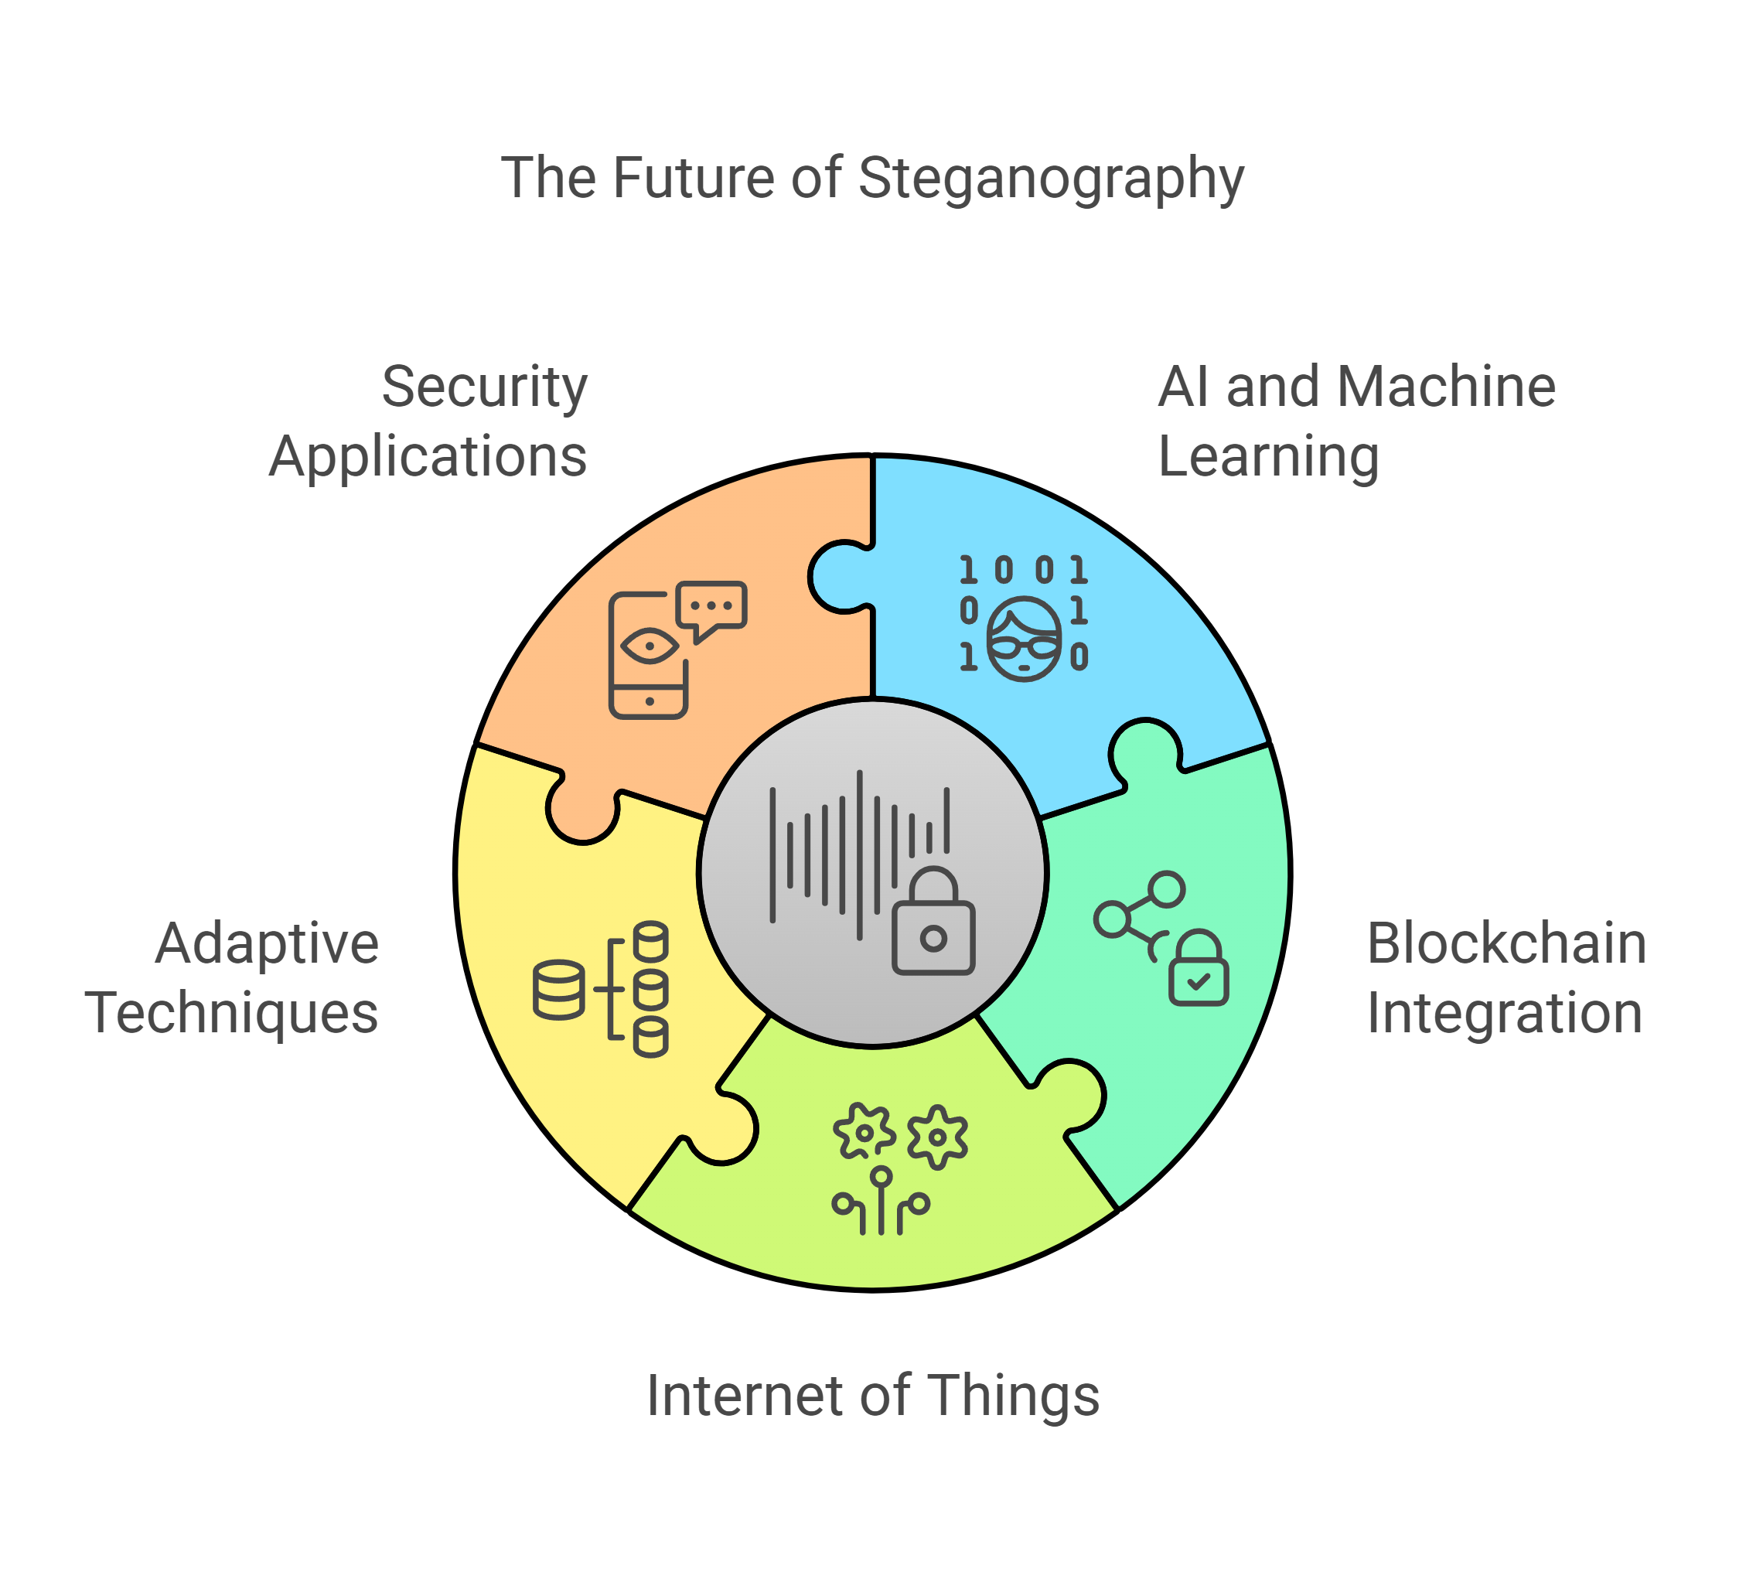
Future scope(optional)
The future scope of steganography is vast and promising, driven by the ever-increasing need for secure and discreet communication in a digital world. As technology evolves, so too will the techniques and applications of steganography. Advancements in artificial intelligence and machine learning can be leveraged to develop more sophisticated embedding algorithms, making hidden data virtually undetectable and highly resistant to steganalysis. Furthermore, the integration of steganography with emerging technologies like blockchain could provide robust solutions for data integrity and secure ownership verification. The expansion of the Internet of Things (IoT) presents new avenues for steganography, where data can be hidden within sensor readings or communication protocols, enhancing privacy and security in interconnected environments. Future research may also focus on developing adaptive steganography techniques that dynamically adjust embedding parameters based on the characteristics of the cover media and the sensitivity of the hidden information. Ultimately, steganography's potential to provide secure and covert communication in various domains, from personal privacy to national security, will continue to drive its development and application.

Slide 14
THANK YOU

